Slide 1



Walchand College Of Engineering, Sangli
(Academic year 2022-23)
Department Of Information Technology
Quiz Buzz
Mini Project – Group No. 5
Under the Guidance of
- Dr. U. B. Chavan

Slide 2

Team Members
Name of Student PRN No.
Trupti Chopadar 2020BTEIT00023
Kanchan Korde 2020BTEIT00065
Sejal Atram 2020BTEIT00067
Mansi Patil 2020BTEIT00068
Dhanashri Maske 2020BTEIT00071
Vaibhav Sonatakke 2020BTEIT00074

Slide 3
Agenda
Introduction
Objectives
Implementation
Technologies Used
Overview
Significance
Future Scope

Slide 4
Introduction:
‘Quiz Buzz’ is an android based application.
This application is used to conduct practice based test.
It contain tests which are based on MCQ pattern with a time limit and score of the test will be calculated at the end.
This app can be provided on student’s mobile as the smartphones are being widely used by students.

Slide 5
Objectives :
To provide greater learning and problem-solving experience for students.
To create an appropriate platform for best management of MCQ tests, details of students and marks.
To release the result of tests as soon as possible which makes it easy for students to identify the gaps in their knowledge.

Slide 6



Technologies used :

Slide 7
Implementation:
User Login :
First users have to register by themselves through Sign-Up
Then they can login to the app.
Users are able to select particular subject for which they want to give test.
Start the test.
After submitting, result will be displayed which also includes rank of users along with score.

Slide 8
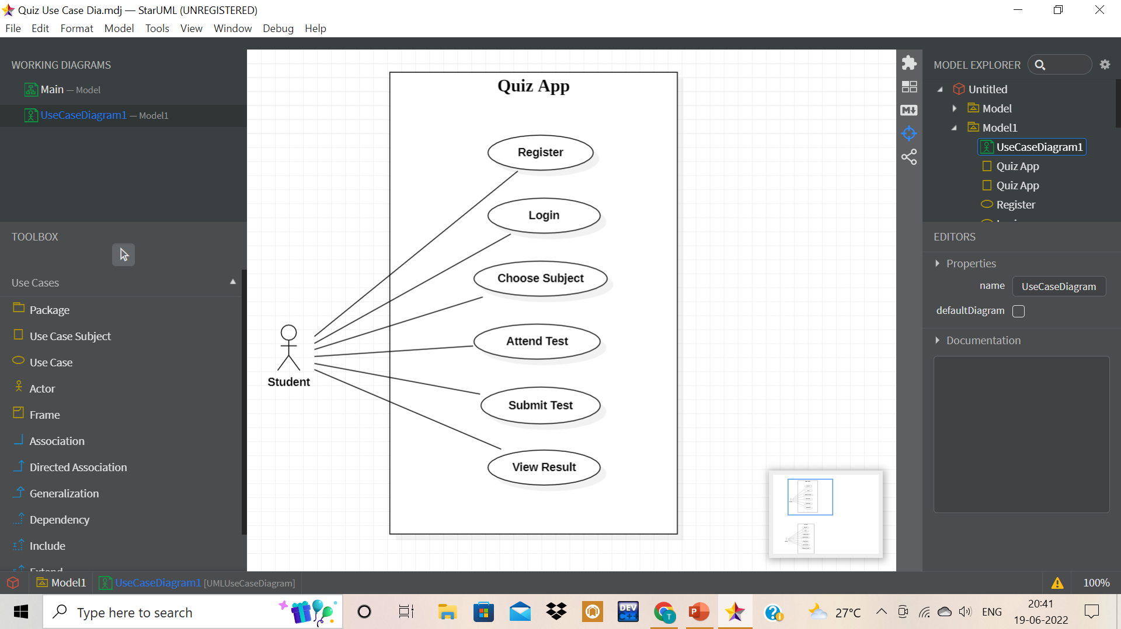
Use Case Diagram for user :

Slide 9
Database Hierarchy :
Users
User
User_Data
Total_Users
Users_Count
My_Score
Test1 Score
Test2 Score
Email_ID
Name
Total_Score
Phone No.

Slide 10
Database Hierarchy :
Quiz
Categories
CAT_ID
CAT_NAME
NO_OF_TEST
TEST_LIST
TEST_INFO
TEST_ID
TEST_TIME
Category
Questions
Question
Options
Category ID
Answer
Test ID

Slide 11



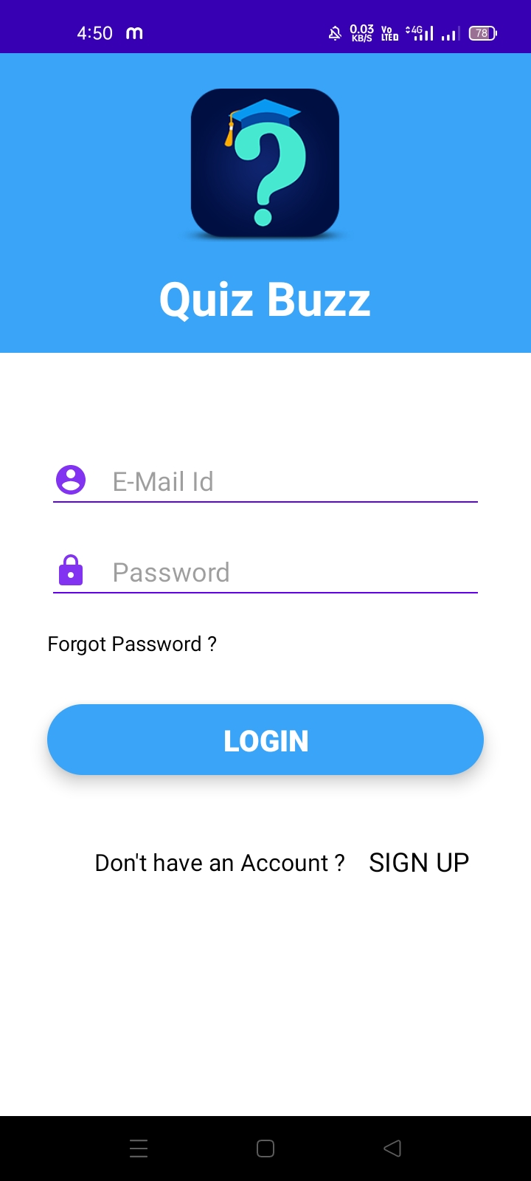
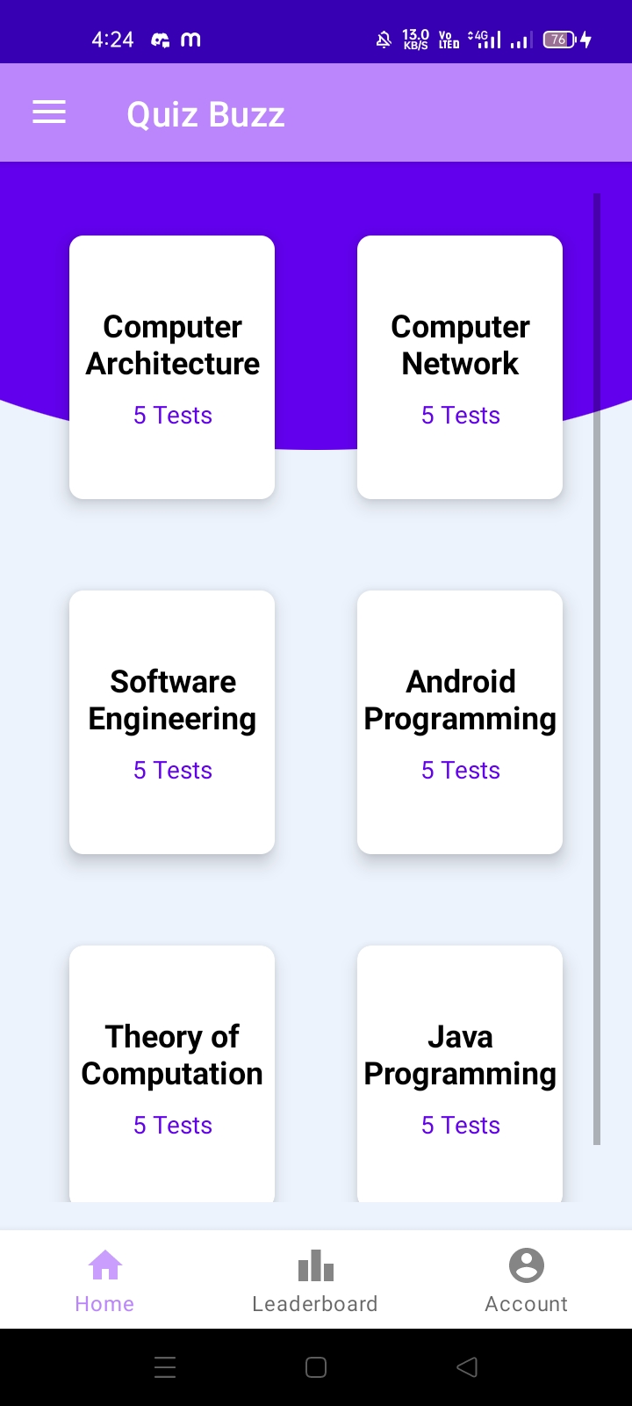
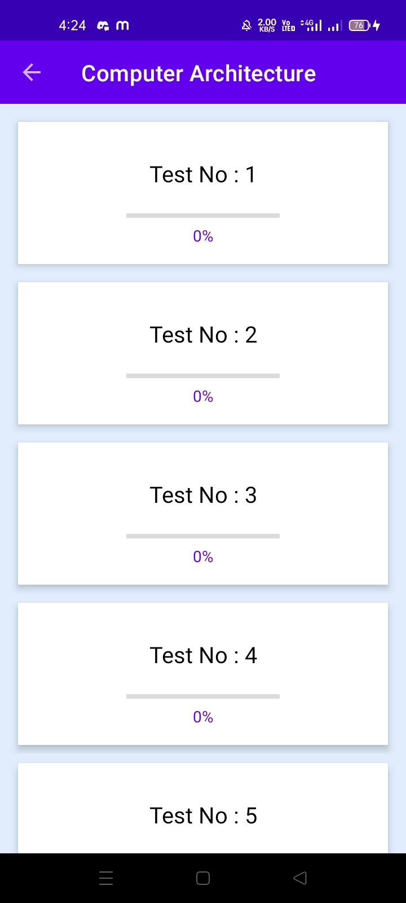
Overview Of Slides:
Login
Categories
Tests
Users need to login with their valid email-ID. If they don’t have account they can register themselves.
Users will able to select one category for which they want to give test.
Users will able to select one test from the test list displayed on the screen then click on start button to start the test.

Slide 12



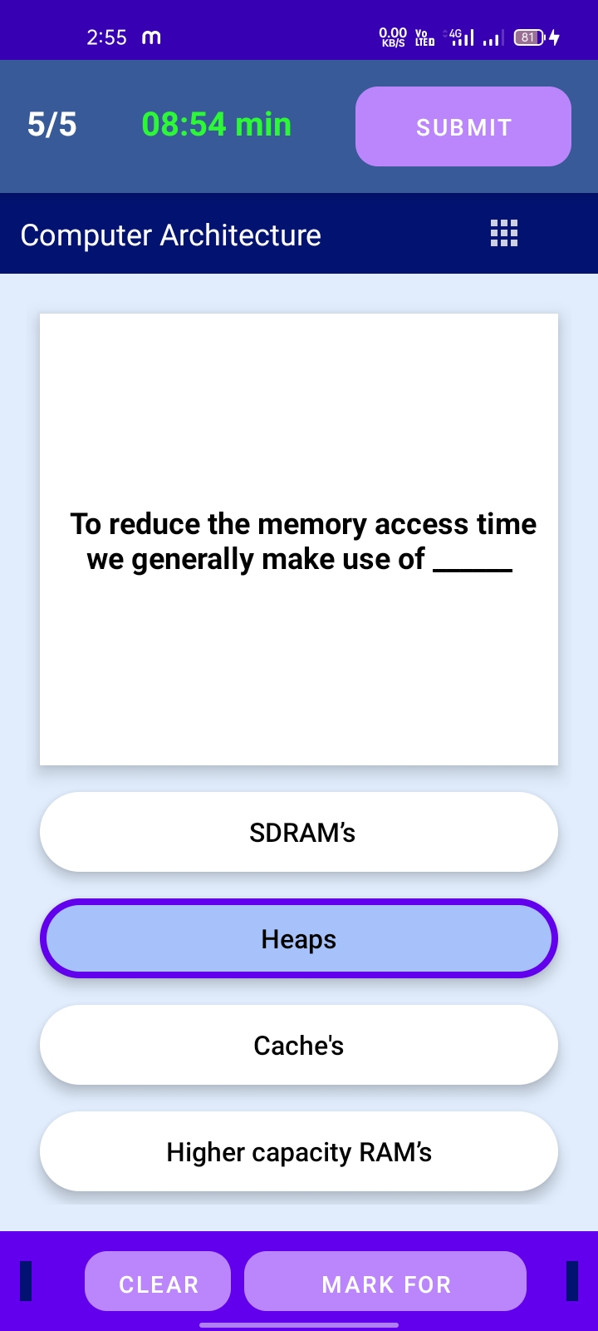
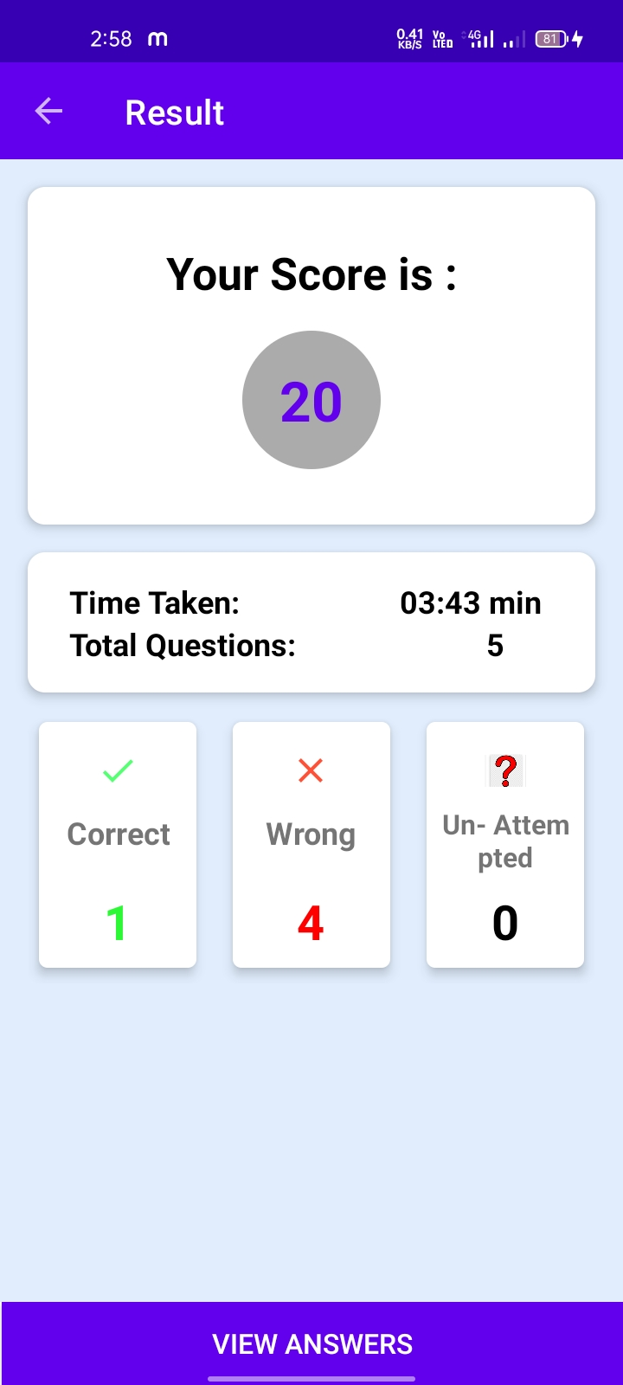
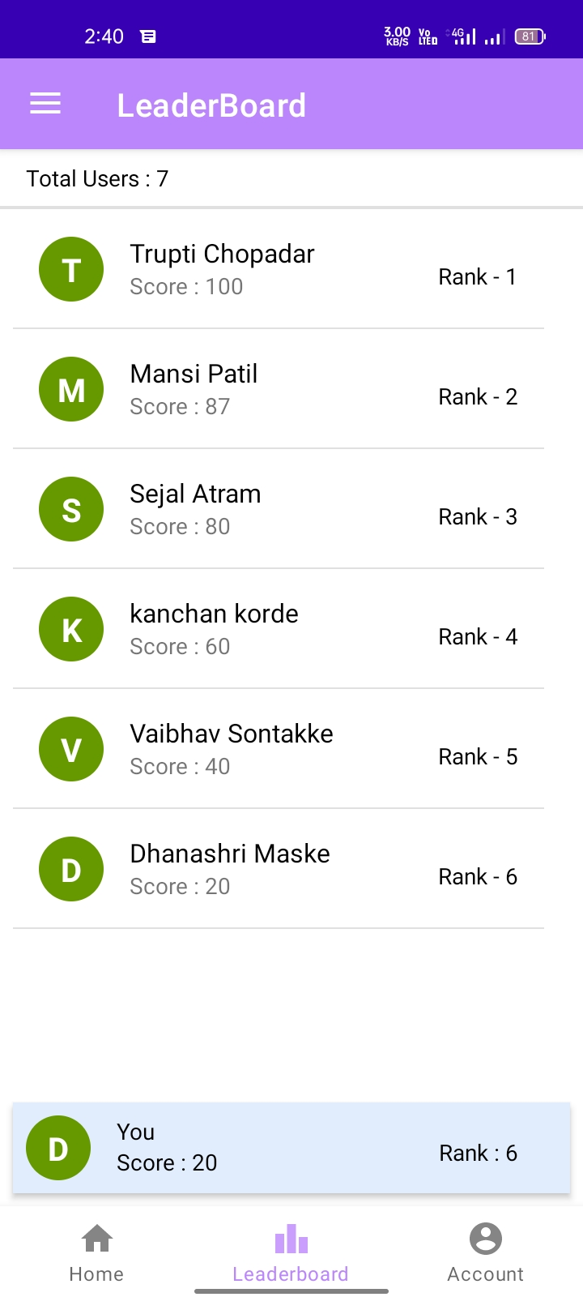
Overview of Slides :
Questions
Score
Rank
Users will able to select correct option from given four options. After completing the test they can submit it.
It displays score and time taken by user to attempt the test. Also, user will able to view correct answers of the test.
User will able to check their ranks in the leaderboard.

Slide 13
Significance :
Reduce manual work and prevent human error.
Maintain details of results and records of students.
Engages its audience : Engage your audience is unique and interesting way.
Taking online quizzes makes it possible to have a large number of participants.
Quick result.

Slide 14
Future Scope :
This app is only for MCQs test but in future we may plan to extend it to support subjective types of questions.
The app is unable to insert images in question so we may add this feature in our application.

Slide 15
References
Android Programming: The Big Nerd Ranch Guide
Java and Software Designs Concepts by Apress
https://www.tutorialspoint.com/java/
https://www.javatpoint.com/java-tutorial
https://docs.oracle.com/javase/tutorial/
https://firebase.google.com/docs

Slide 16

Thank You

